Slide 1
IP Concerns for the General Practitioner
Chris Ott
Senior Counsel, Payless ShoeSource
September 21, 2017
Notes:
About me
Payless way – of course we can’t do things easily, need (at least) 4 different ways to offer products
Roadmap – IP 101 to cover the different types of intellectual property we own/license; focus on licenses, summary of special issues

Slide 2
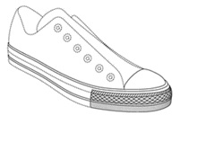
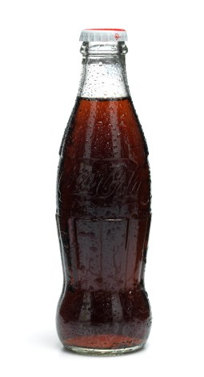
Trademarks and Trade Dress
Words and Phrases
PAYLESS
YOU’RE FIRED
Trade Dress
Designs and Images
Notes:
Anything capable of distinguishing the source of goods and services
Trademarks protect words, names, symbols, devices
Don’t exist in a vacuum – connected to particular goods and services
Unique focus on consumer and how the consumer perceives the marks
Mark importance: Symbol of goodwill – informs consumers of the quality associated with product; Distinguish between competing products (Kansas v Kansas State); Signifies goods or services coming from a single source

Slide 3
Trademarks – Establishing Protection
Common law
Use
Geographically limited
Internet?
Prior user
Federal Registration
Validity
Constructive notice
Distinctiveness
Fanciful/Coined
Arbitrary
Suggestive
--------------
Descriptive
Generic
Notes:
Search and clearance – balance between business wanting descriptive and attorneys wanting things perfect

Slide 4
Trademarks – Common Issues
Ownership
® v ™
Responding to or Issuing Demands
Do you have a mark?
Priority
Geographic reach
Is there a Likelihood of Confusion?
Domain Names and Social Media
Notes:
Ownership – generally resides with the entity using the mark
® - mark should be registered

Slide 5
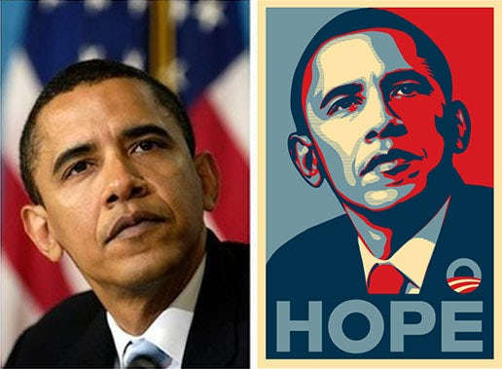
Copyrights
Notes:
Copyrights protect original works of authorship that are affixed in a tangible medium (Text (must be long enough to be recognizable) , photos, music, art)
Shephard Fairey – bases his iconic image on a photo taken from the AP. AP files suit – difficult balance because the image would never have been famous without Fairey. Provide attribution
Mad Men
Script
Cameraperson
Music
Term is currently 95 years from publication (basically offered for sale)

Slide 6
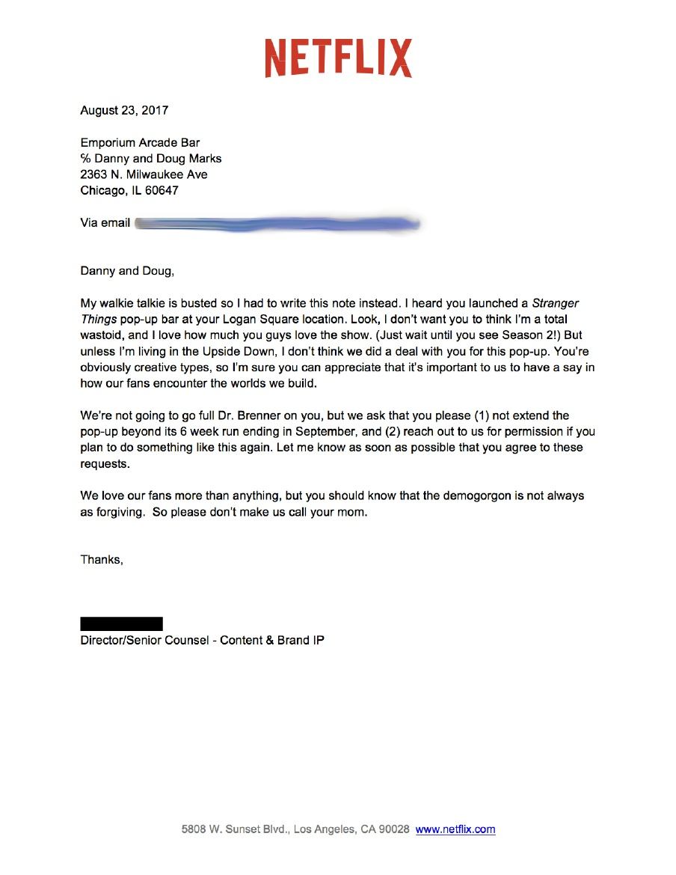
Copyright – Common issues
Ownership and Assignment
Registration
Infringement
Fair Use
Notes:
Owner is author
Exception is stuff generated in scope of employment; Work for hire
Registration is necessary to bring suit; registering early allows statutory damages
Infringement is based on access + similarity.
Fair use – almost certainly not available to us because of commercial nature of our business

Slide 7
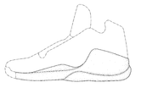
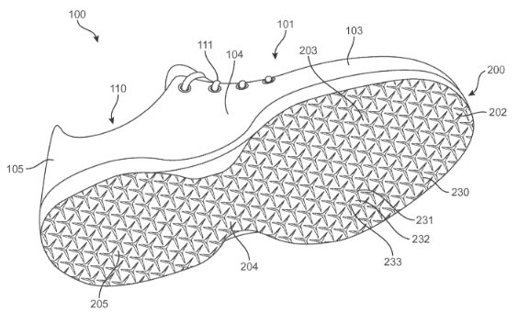
Patents
Design patent
Utility patent
The ornamental design for a shoe midsole.
What is claimed is:
1. An article of footwear comprising:
a sole structure comprising an auxetic layer and a first liner,
wherein the auxetic layer includes a pattern of apertures formed by sole elements surrounding the apertures;
wherein each of the sole elements has a plurality of vertices;
wherein the sole elements are joined at their vertices, and wherein the sole elements can rotate with respect to one another about their vertices;. . .
Notes:
Protect Inventions, Processes, and Methods
Utility (Novel and Non-obvious): 20 years; Design (Ornamental design of a functional item) – 14 years Ownership: Inventor; rights only come through registration Real world: (1) Apple v Samsung; (2) Patent trolls Infringement: Substantial similarity (“reads on”); claim construction

Slide 8
Patents – Common Issues
Must register
Ownership and assignments
Infringement
Notes:
USA is now a first to file jurisdiction (like the rest of the world)

Slide 9
IP 101 – Other Intellectual Property
Trade secrets
Right of Publicity
Notes:
Trade secret: Parties agree to keep something secret; generally maintained through NDAs.
Examples: KFC, Coke recipe (Pepsi secretary)
Right of publicity: Governed by state law (California being most prominent)
Russell Christoff posed for 2 hours for a photo shoot and understood that he would be paid $2000 if his photo was used in Canada. Never hears back. His image was used worldwide and he learns of it in 2002. In 2005, a California jury awarded him $15.6 million but was ultimately reversed
Right of publicity isn’t recognized in Kansas (but is in Missouri). Can sometimes squeeze in as an invasion of privacy tort. Elements in Missouri: (1) D used P’s identity, (2) without consent, and (3) with the intent to obtain a commercial advantage.

Slide 10
Thanks!
Stump the Speaker
Christopher.ott@payless.com
785.295.2097

